Slide 1
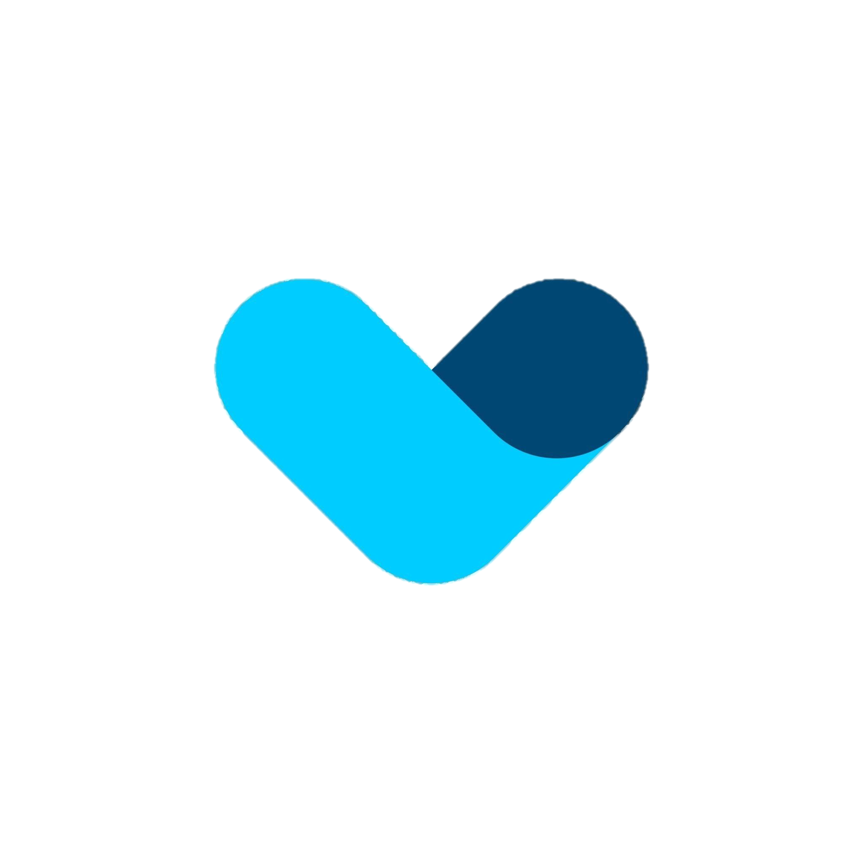
Micro SAAS Startup Session 0
Foundation session
SAAS Startup Session

Slide 2
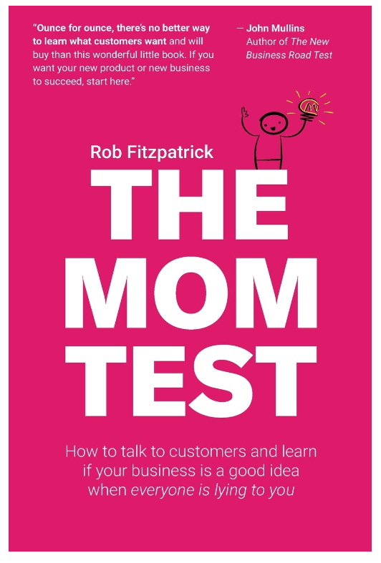
1. Validate business idea
Reach by Email, LinkedIn, Zoom, Facebook groups, Discord groups…
Survey customers
Ask if they got this problem,
how significant it is
and have they solved it?
SAAS Startup Session

Slide 3
Micro SAAS Startup Mytes
Myth: A great product guarantees success.
Myth: You need to work 24/7.
Myth: Building the product is the hardest part.
Myth: You need a unique idea.
Myth: Failure is the end.
Myth: Work-life balance isn't important.
Truth: Balance is crucial for well-being.
Truth: Failure is a learning experience.
Truth: Success can come from offering a better solution or niche focus.
Truth: Scaling, marketing, and management are demanding.
Truth: Balance is crucial; burnout is counterproductive.
Truth: Success depends on marketing, business negotiation, and more.
SAAS Startup Session

Slide 4
"The Lean Startup" - Recruitment SAAS
Hypothesize: Start with assumptions about your job board's value and user experience.
MVP: Develop a basic job board to test your assumptions.
Measure: Track key metrics like user engagement, job postings, and user feedback.
Learn: Analyze data to validate assumptions and identify areas for improvement.
Pivot or Persevere: Be ready to change if needed, or continue refining what works.
Customer Feedback: Engage with users to understand their needs and preferences.
Continuous Updates: Regularly improve the job board based on feedback and data.
Actionable Metrics: Focus on metrics that guide your decisions, like successful placements.
Financial Insights: Apply innovative financial tracking to assess costs and revenue.
Growth Strategies: Experiment with user acquisition and engagement tactics.
User-Centric Design: Prioritize user experience, continually enhancing based on feedback.
SAAS Startup Session

Slide 5
Drawbacks – Micro-SAAS
Customer support is difficult
Demos for SAAS products can take a lot of time
and its not profitable if you have a low paying subscription client
if you have lots of low paying clients
Getting Leads to Sign Up
to your Service from your Ads is costly in time and money
Chat support on odd hours
from leads or customers
Complicated SAAS products requires more customer support
Reliance of external providers
Web host increase their price,
API providers updates their system requiring you to update yours too
SAAS Startup Session

Slide 6
Selling Techniques in Micro SAAS
Value Selling:
Target Account Selling (TAS):
Quantify the real value your product offers, crucial in justifying SaaS prices.
Ideal for enterprise-focused SaaS, emphasizing quality over quantity, and building relationships during the sales process.
SAAS Startup Session

Slide 7
SAAS Contract key Clauses
Services: Describe the SaaS platform and its features.
Fees: Outline the pricing and payment terms.
Term and Termination: Specify contract duration and termination conditions.
Service Changes and Updates: Detail service updates and changes.
Price Increases:
Include provisions for price increases, specifying notice periods and limits on the increase percentage.
SAAS Startup Session
SaaS Contracts - Key terms to include - YouTube

Slide 8
SAAS Contract key Clauses
Exit Strategy: Explain transition and termination procedures.
Amendment: Define how the contract can be amended.
Force Majeure: Include unforeseen event provisions.
Auto Renewal: Specify terms for automatic renewal and how to opt out.
Trial Period: If applicable, outline the terms of any trial or evaluation period.
SAAS Startup Session
SaaS Contracts - Key terms to include - YouTube

Slide 9
SAAS Contract key Clauses
Support and Maintenance: Describe customer support and maintenance.
Price Protection:
Detail any price protection clauses, such as fixed pricing for a specified duration, in this case, three years.
SLAs: Include service level agreements if applicable.
Minimum Amount of Users: Include terms regarding the minimum number of users.
New Features: Clarify how new features or modules will be introduced and priced.
SAAS Startup Session
SaaS Contracts - Key terms to include - YouTube

